Slide 1
Advanced Training on Cloud-based Website CMS Using Wix
24 Jan 2019

Slide 2
About me
THE UNIVERSITY OF HONG KONG
Information Technology Service
Michelle Cheung
Tel: 3917 6285
Email: michellc@hku.hk

Slide 3
Agenda
Foundation
Practical
https://www.hkumockup.its.hku.hk/

Slide 4
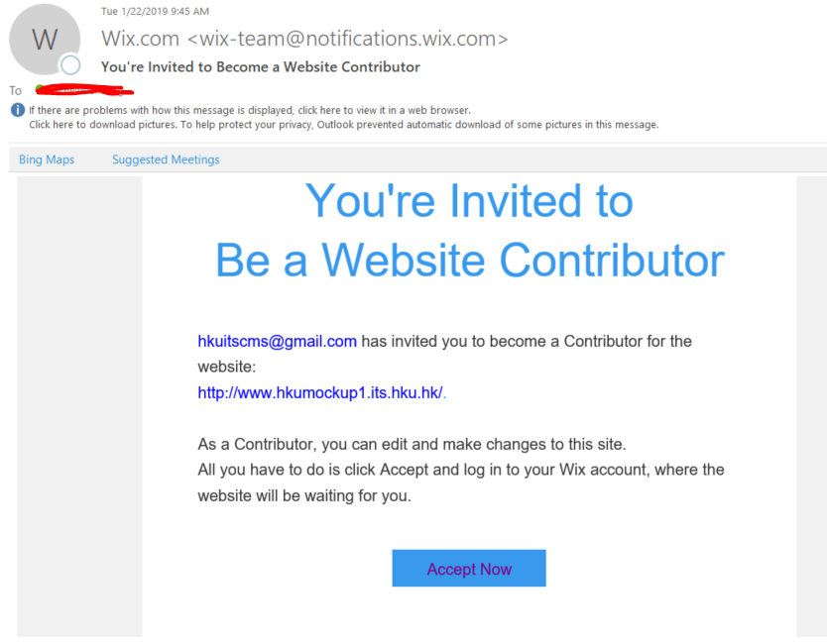
Get Ready to start Wix Training
Get a handheld on Desk or from Tutor
Do the steps in handheld to login PC and get the Training Material.
If you did not found the invitation email, talk to Tutor.
Invitation email

Slide 5
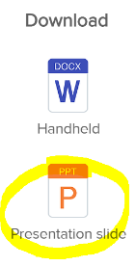
Training Material
Login your HKU email https://hkucc1.hku.hk/owa/ , find an email subject “You're Invited to Become a Website Contributor” click the “Accept Now”
Click “Login to accept” if you already signup a Wix account, otherwise, click “Create account & accept” to sign up a new Wix account.
From the site list, select the one named with Wix Advanced XX, click “Select & Edit Site”
Download the presentation slide from https://www.hkumockup.its.hku.hk/

Slide 6
Your Wix Site domain
https://hkumockupxx.its.hku.hk
xx (1-30)
Do not put any personal information / sensitive data in the Wix site
The site is in production

Slide 7
Common Wix Code
Selector | $w(‘#id’)
Link | $w(‘#id’).src =
Text | $w(‘#id’).text
Button text | $w(‘#id’).label
Style Bg color Text color Border color | $w(‘#id’).style $w(‘#id’).style.backgroundColor $w(‘#id’).style.borderColor $w(‘#id’).style.color
Scroll | $w(‘#id’).scrollTo()
Test output | console.log(‘test’)
Join 2 string | = ‘Hello’ + username
define | let, const
For loop | for(condition){ }
If loop | if(condition){ }
On load | $w.onReady(function(){ })
Check browser info Device Window size Pops up | import wixWindow from 'wix-window’; wixWindow.formfactor wixWindow.foWindowSizeInfo wixWindow.openLightbox(‘lightboxname’)
redirect | import wixLocation from 'wix-location’; wixLocation.to()
Reference: https://www.wix.com/code/reference/Cheatsheet.html

Slide 8
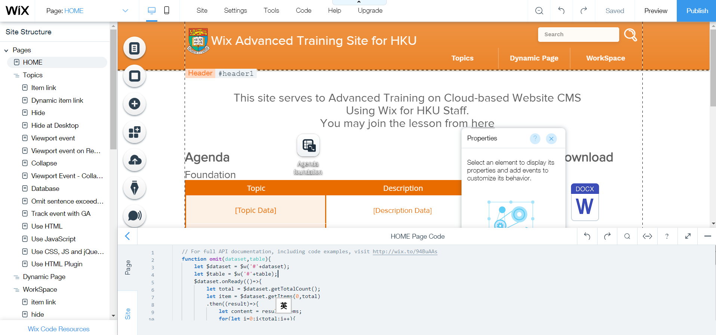
Teach
Practice

Slide 9
Turn on Developer Tool

Slide 10
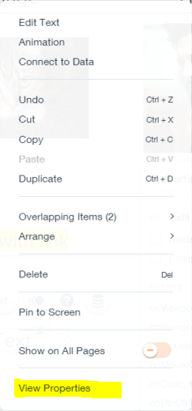
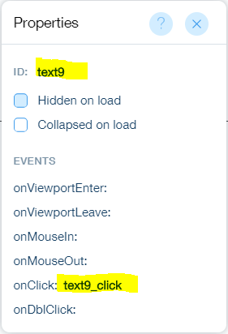
Tips – view “View Properties”
Right click the item “Text”, click “View properties”

Slide 11
Item link
1 import wixLocation from 'wix-location';
2 export function text9_click(event) {
3 wixLocation.to("/blank");
4 }
/blank: the path to redirect the page
Do NOT copy code from ppt, please copy from Wix -> Topics -> …

Slide 12
Try yourself - Item link
WorkSpace -> item link
Add: import wixLocation from 'wix-location’;
Add onClick function to each box
Link home box page: add wixLocation.to("/home-1 "); inside
Link beast box to page: wixLocation.to("/beast ");
Link beauty box to page: wixLocation.to("/beauty");
Publish
Reference: https://hkumockup.its.hku.hk/p-item-link
export function xxxx_click(event) {
//add in here
}

Slide 13
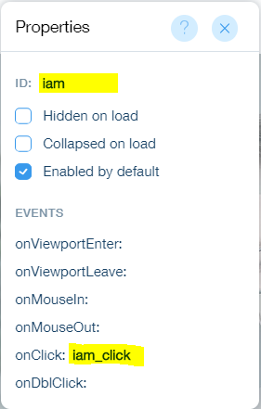
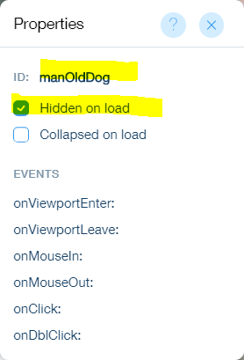
Hide
1 export function iam_click(event) {
2 let $pic = $w('#manOldDog');
3 if($pic.hidden){
4 $pic.show();
5 }else{
6 $pic.hide();
7 }
8 }

Slide 14
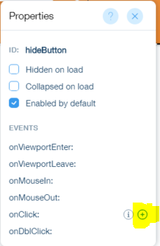
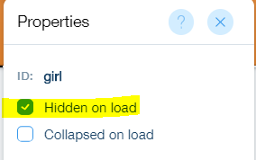
Try yourself - Hide
(1)
WorkSpace -> hide
Hide the girl image on load
When click “Show what I am hiding”, Girl image display
Add onClick function for the button
Add below inside function
Reference: https://hkumockup.its.hku.hk/p-hide
(2a)
let $pic = $w(‘#girl');
if($pic.hidden){
$pic.show();
}else{
$pic.hide();
}

Slide 15
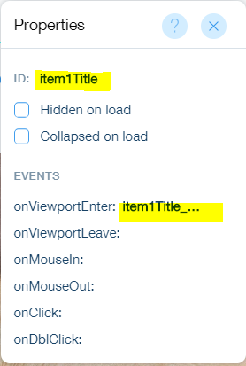
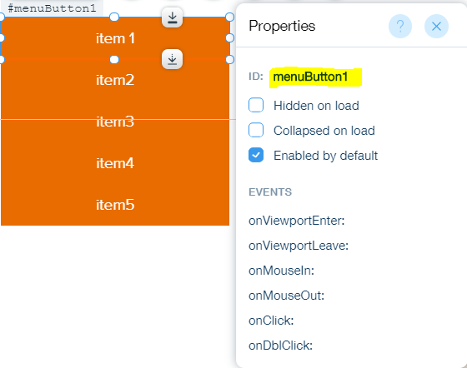
Viewport event
1 function inView(menuID) {
2 $w('#menuButton' + menuID).style.backgroundColor = '#F0B078’;
3 [1, 2, 3, 4, 5].filter(idx => idx !== menuID).forEach(idx => {
4 $w('#menuButton' + idx).style.backgroundColor = '#E86C00’;
5 })
6 }
7 export function item1Title_viewportEnter(event) {
8 inView(1)
9 }
淺橙色
鮮橙色

Slide 16
Viewport event
1 function inView(menuID) {
2 $w('#menuButton' + menuID).style.backgroundColor = '#F0B078’;
3 [1, 2, 3, 4, 5].filter(idx => idx !== menuID).forEach(idx => {
4 $w('#menuButton' + idx).style.backgroundColor = '#E86C00’;
5 })
6 }
7 export function item1Title_viewportEnter(event) {
8 inView(1)
9 }
In view
Not in view
style.backgroundColor
style.borderColor
style.color (字顏色)
Repeat function for all viewport
1 : 1 – 5 (the ID of the menu button)
1, 2, 3, 4, 5: (all the IDs of menu button)

Slide 17
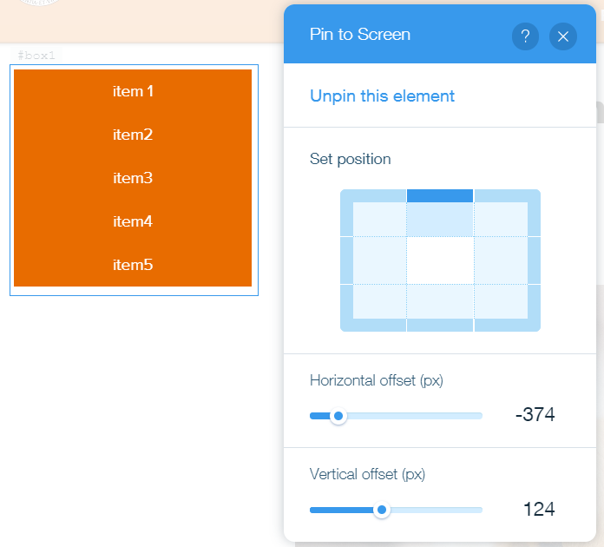
Tips – pin sub-menu on page
Pin to screen)
attach all the buttons in a box, set the box to pin to screen.
user no need to scrolling top to use menu.

Slide 18
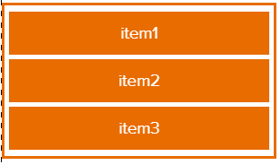
Try yourself - Viewport event 1
WorkSpace -> Viewport event
Add anchor above each title
Add 2 more buttons, put inside box
(edit ID to menuButton2, menuButton3)
Add viewport event on each title
Pin the menu to screen
(3)
(4)

Slide 19
Try yourself - Viewport event 2
5. add below function at top
6. Add inView(1) inside
7. Add inView(2) …..(repeat for other 2 title)
Reference: https://hkumockup.its.hku.hk/viewport-event
function inView(menuID) {
$w('#menuButton' + menuID).style.backgroundColor = '#F0B078';
[1, 2, 3].filter(idx => idx !== menuID).forEach(idx => {
$w('#menuButton' + idx).style.backgroundColor = '#E86C00';
})
}

Slide 20
Collapse
Menu 1
button
item 1
item 2
item 3
item 4
box
repeater

Slide 21
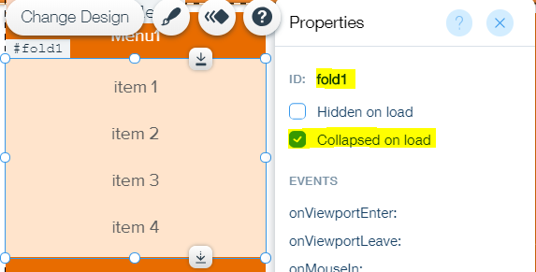
Collapse
1 function toggleFold(index) {
2 let $fold = $w('#fold' + index);
3 if ($fold.collapsed) {
4 $fold.expand();
5 } else {
6 $fold.collapse();
7 }
8 [1, 2, 3].filter(idx => idx !== index).forEach(idx => {
9 $w('#fold' + idx).collapse()
10 })
11 }
1, 2, 3: (all the IDs of menu button lv1)

Slide 22
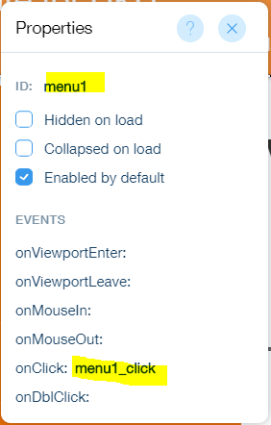
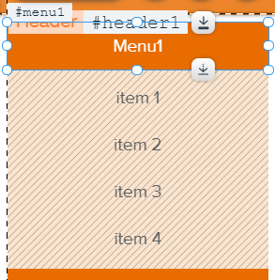
Collapse
1 export function menu1_click(event) {
2 toggleFold(1)
3 }
Menu
fold

Slide 23
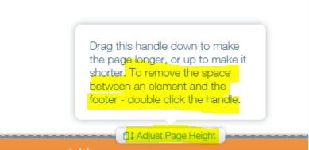
Tips – Collapse (auto adjust page height)
Double click "adjust page height"
https://www.wix.com/code/home/example/Collapse-Elements

Slide 24
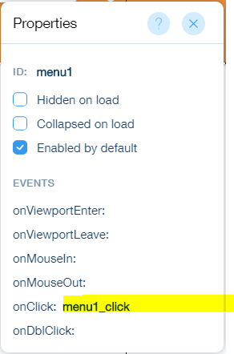
Try yourself - Collapse 1
WorkSpace -> Collapse
Add 2 more buttons and boxes
Attach repeater to box
Add button to repeater
You should have 3 sets menu
Link each anchor to button
Add onClick function to 3 menu buttons
Next page… …
(6)

Slide 25
Try yourself - Collapse 2
function toggleFold(index) {
let $fold = $w('#fold' + index);
if ($fold.collapsed) {
$fold.expand();
} else {
$fold.collapse();
}
[1, 2, 3].filter(idx => idx !== index).forEach(idx => {
$w('#fold' + idx).collapse();
})
}
Add below function at top
Add toggleFold(1) inside
Add toggleFold(2) … … repeat to other 2
Reference: https://hkumockup.its.hku.hk/p-collapse

Slide 26
What is Google Analytics
Tack user behavior for marketing purpose
Number of page view
User using which Browser (Mobile, Desktop, Chrome, Safari…)
User come from which platform (from Google search, Facebook)
Notes:
Introduction of Google Analytics

Slide 27
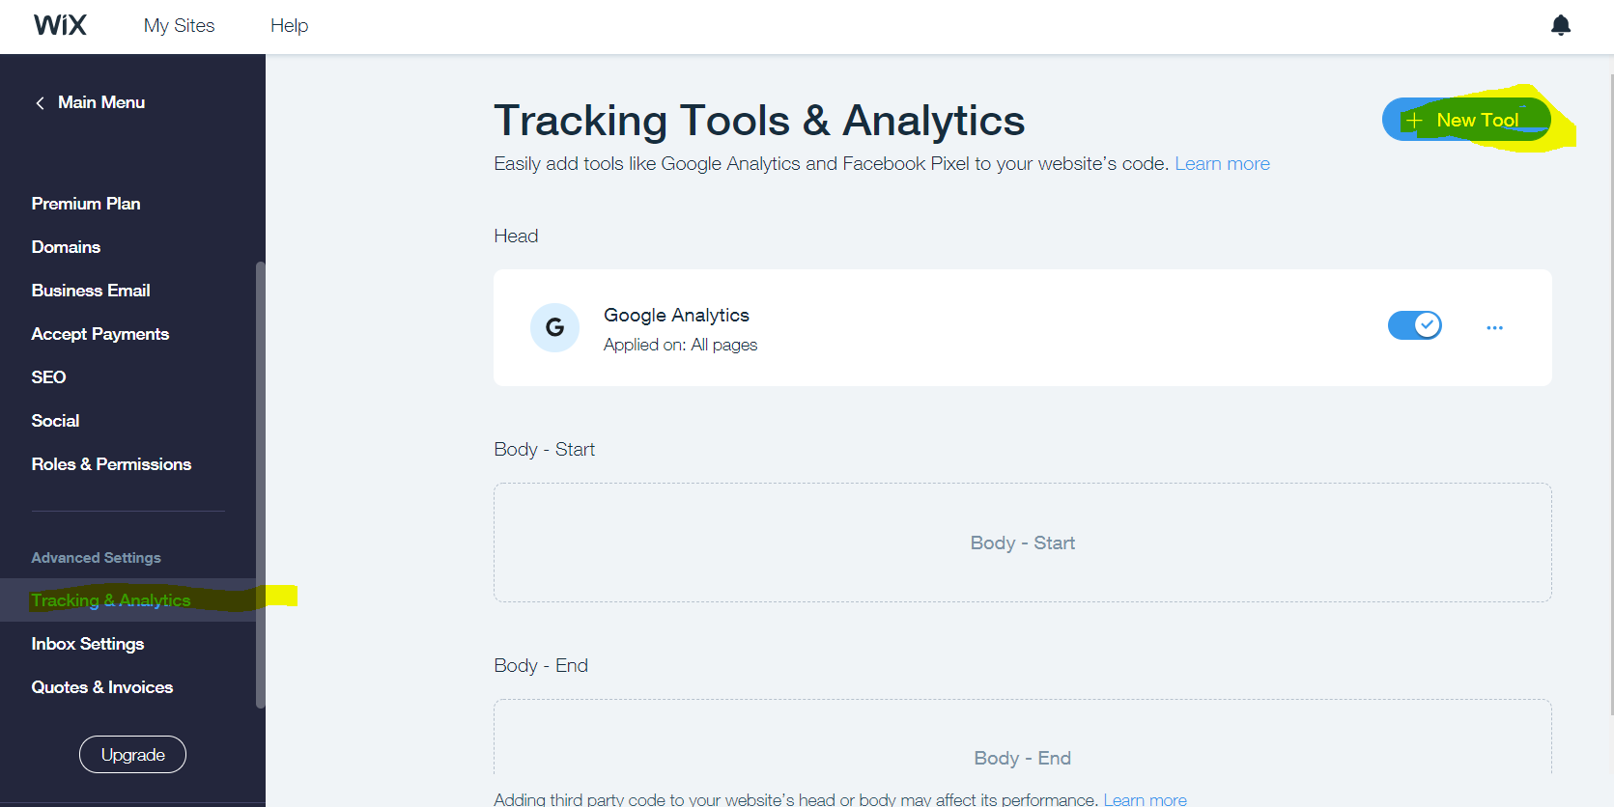
Google Analytics
Only for Wix site with Premium Plan & domain connection
Create Google Analytic track:
https://hkumockupxx.its.hku.hk
Time zone: Hong Kong
Steps to create a track ID:
https://www.cms.its.hku.hk/basic

Slide 28
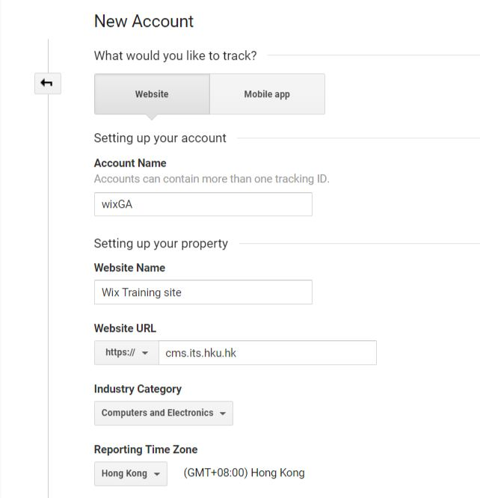
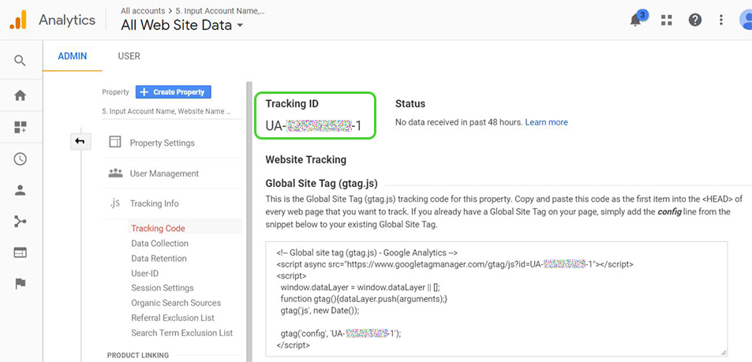
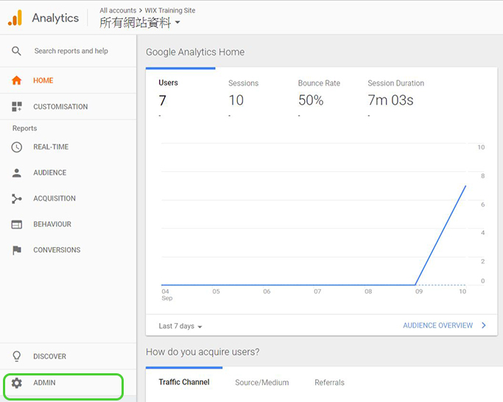
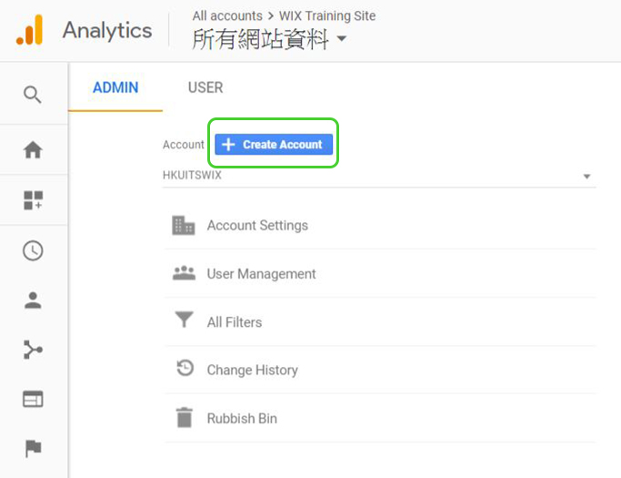
Signup Google Analytics
Visit Google Analytics, login using google account
https://hkumockupxx.its.hku.hk
Time zone: Hong Kong

Slide 29
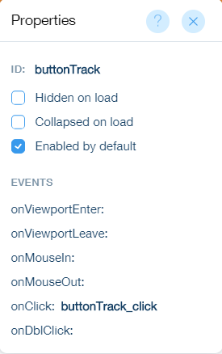
Google Analytics
1 import wixWindow from 'wix-window';
1 function ga(category, value) {
2 wixWindow.trackEvent("CustomEvent", {
3 "eventCategory": category,
4 "eventAction":value
5 } );
6 }
1 export function buttonTrack_click(event) {
2 ga('test button click','test’);
3 }

Slide 30
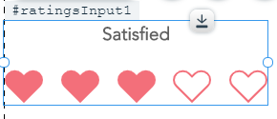
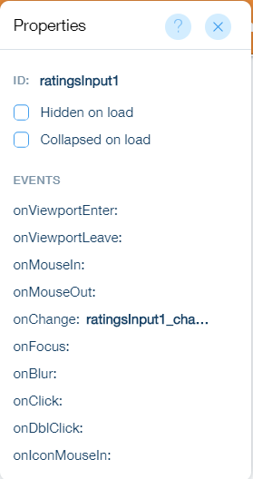
Google Analytics
1 export function ratingsInput1_change(event) {
2 let value = $w('#ratingsInput1').value;
3 ga('rating site',value);
4 }
https://www.wix.com/code/reference/wix-window.html#trackEvent

Slide 31
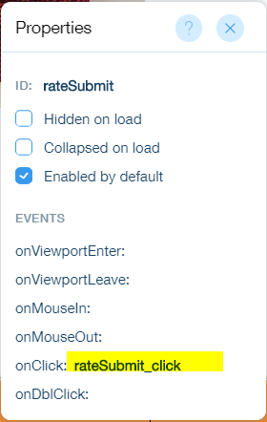
Try yourself - Google Analytics
WorkSpace -> Track event with GA
Create Track ID and set in Wix Dashboard -> Setting -> Tracking & Analytics
Add import wixWindow from 'wix-window’; at top
Add below function after
add onClick function on “Submit”button
Add below code inside
Reference: https://hkumockup.its.hku.hk/p-track-ga
function ga(model, rate) {
wixWindow.trackEvent("CustomEvent", {
"eventCategory": model,
"eventAction":rate
} );
}
ga('ModelA',$w('#rateModelA').value);
ga('ModelB',$w('#rateModelB').value);
ga('ModelC',$w('#rateModelC').value);
$w('#result').show();
$w('#rateSubmit').disable();
(4)

Slide 32
Google Search Tool
Only for Wix site with Premium Plan & domain connection
import wixWindow from 'wix-window';
import wixLocation from 'wix-location';
1 function ga(action, keyword){
2 wixWindow.trackEvent("CustomEvent", {
3 "eventCategory": "Google Search tool",
4 "eventAction": action,
5 "eventLabel":keyword
6 } );
7 }
1 export function searchIcon_click(event, $w) {
2 let baseUrl = wixLocation.baseUrl.substr(8);
3 let searchContent = $w('#searchInput').value;
4 ga("click", searchContent);
5 wixLocation.to("https://www.google.com/search?&q="+ searchContent +"+site%3A" + baseUrl);
6 }

Slide 33
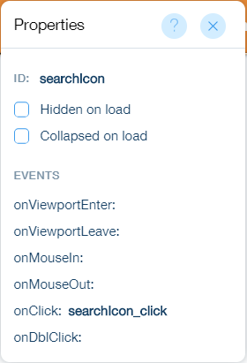
Google Search Tool
1 function ga(action, keyword){
2 wixWindow.trackEvent("CustomEvent", {
3 "eventCategory": "Google Search tool",
4 "eventAction": action,
5 "eventLabel":keyword
6 } );
7 }
8
https://xxxxx.hku.hk
1 export function searchIcon_click(event, $w) {
2 let baseUrl = wixLocation.baseUrl.substr(8);
3 let searchContent = $w('#searchInput').value;
4 ga("click", searchContent);
5 wixLocation.to("https://www.google.com/search?&q="+ searchContent +"+site%3A" + baseUrl);
6 }
:

Slide 34
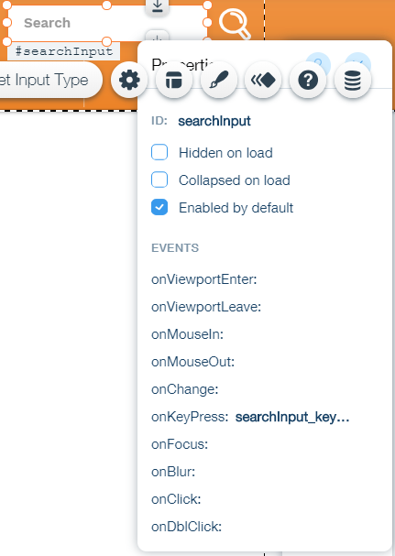
Google Search Tool
1 export function searchInput_keyPress(event) {
2 let baseUrl = wixLocation.baseUrl.substr(8);
3 if (event.key === "Enter") {
4 let searchContent = $w('#searchInput').value;
5 ga("keyPress", searchContent);
6 wixLocation.to("https://www.google.com/search?&q="+ searchContent +"+site%3A"+baseUrl);
7 }
8 }
Press “Enter” on keyboard
https://www.wix.com/code/reference/wix-window.html#trackEvent

Slide 35
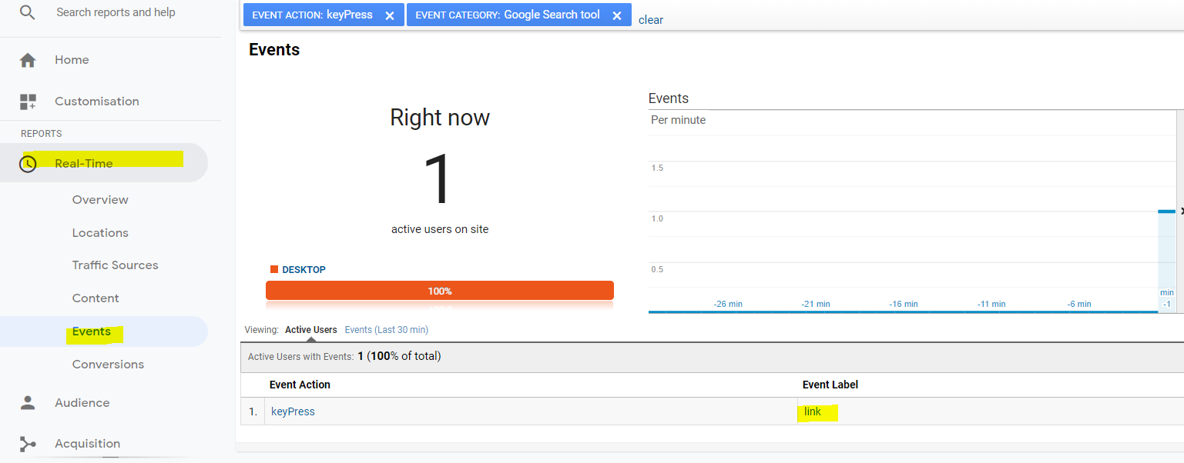
Google Search Tool – Google Analytics

Slide 36
Try yourself - Google Search Tool
Home page
Add a Input, edit ID to “searchInput”
Add onKeyPress function
Add , Add onClick function
Reference: https://hkumockup.its.hku.hk/ site code
let baseUrl = wixLocation.baseUrl.substr(8);
if (event.key === "Enter") {
let searchContent = $w('#searchInput').value;
ga("keyPress", searchContent);
wixLocation.to("https://www.google.com/search?&q="+ searchContent +"+site%3A"+baseUrl);
}
let baseUrl = wixLocation.baseUrl.substr(8);
let searchContent = $w('#searchInput').value;
ga("click", searchContent);
wixLocation.to("https://www.google.com/search?&q="+ searchContent +"+site%3A" + baseUrl);

Slide 37
Using JavaScript
DOM
Public
import {functionName} from ‘public/JavaScript.js’
JavaScript
.js
Client-side
Wix Page Code
Backend
Web Module
.jsw
JavaScript
.js
import {functionName} from ‘backend/webModule.jsw';
import {functionName} from 'backend/JavaScript.js’

Slide 38
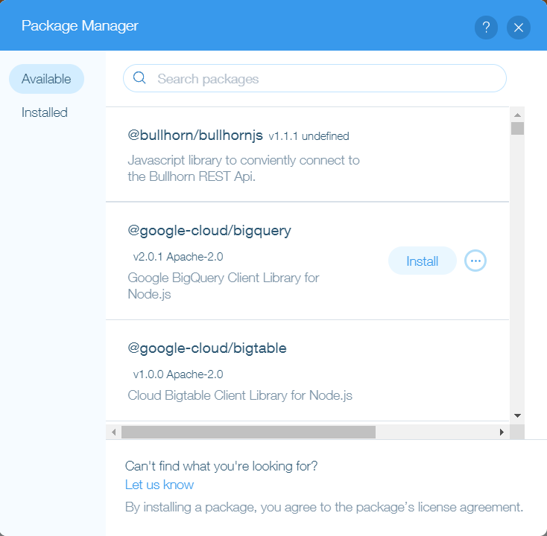
Using JavaScript – install Node Package

Slide 39
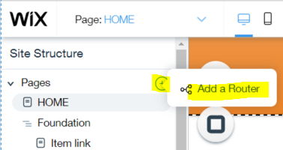
Using JavaScript - router.js
Site A
Site B
Its.hku.hk
Its.hku.hk/cms
Register new domain (CF60):
cms.Its.hku.hk
WebCloud
Apply Letsencrypt (ithelp@hku.hk):
https://cms.its.hku.hk
Revamp to Wix
Its.hku.hk
Wix Site
Wix can not share domain name
https://domainname.hku.hk/foldername/filename.html
1 import {redirect} from "wix-router"; 2 export function cms_Router(request) {
3 return redirect("https://cms.its.hku.hk");
4 }
https://support.wix.com/en/article/wix-code-how-to-create-a-router

Slide 40
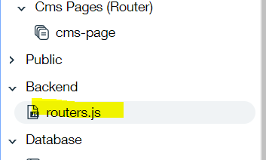
Try yourself - Using JavaScript - router.js
Backend -> router.js
Add a rounter
Hover Page, click Add a Router
Click Start Creating
Input staff
Use exiting js “router.js”
Copy code inside comment to inside
3. Below page will redirect
https://hkumockup.its.hku.hk/staff -> https://www.eee.hku.hk/people/
https://hkumockup.its.hku.hk/staff/scchan -> https://www.eee.hku.hk/people/scchan/
https://hkumockup.its.hku.hk/staff/ktchau -> https://www.eee.hku.hk/people/ktchau/
(1a)
(1b)
(1c)

Slide 41
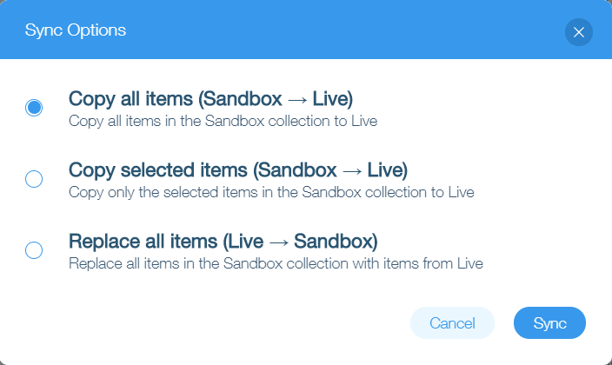
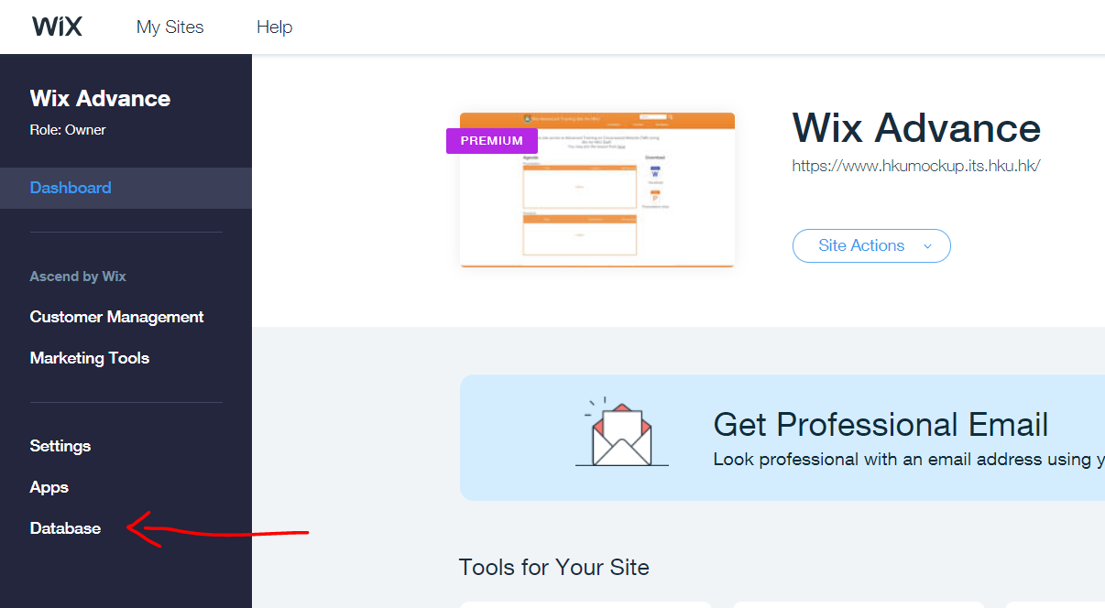
Database – Sandbox & Live

Slide 42
Database – filter and sort
dataset
Filter: name is Peter
gender is F
age greater than18
age does not equal to 18
Sort: sort by name A->Z
sort by age low -> high
name | Gender | age
Mary | F | 15
Peter | M | 17
Connie | F | 18
Jack | M | 16
May | F | 19

Slide 43
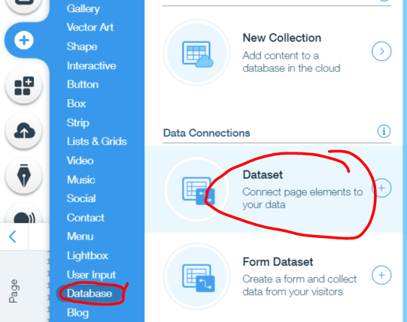
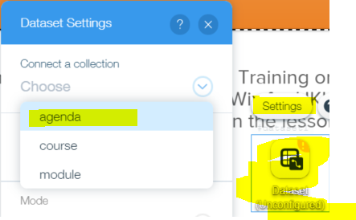
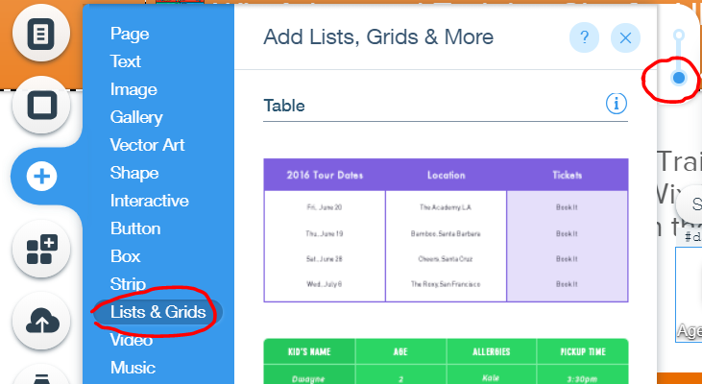
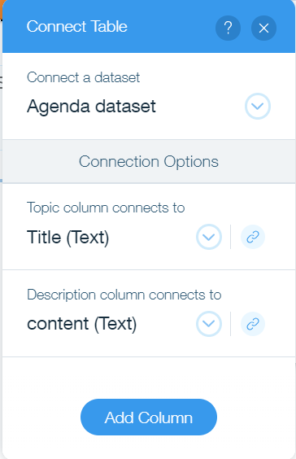
Try yourself - Database
(1)
(1a)
WorkSpace -> Database
Add a Dataset
Connect Dataset to agenda
Filter record which “Self-learning” is not TRUE
Sort by “code”, A->Z
Add a table
Connect to the dataset created above
Add a transparent box at bottom.
Reference: https://hkumockup.its.hku.hk/p-database
(2)
(3)

Slide 44
Dynamic Pages

Slide 45
Dynamic Pages - Use Database
Database ER diagram
Module
PK | Module code
 | Module name
 | content
FK | Course code
Course
PK | Course code
 | Course name
 | About
FK | Module code
FK | Requirement code
many to many
many to one
requirement
PK | Requirement code
 | content

Slide 46
Dynamic Pages - Use Database
Database ER diagram
Module
PK | Module code
 | Module name
 | content
FK | Course code
Course Module
FK | course code
FK | Module code
Course
PK | Course code
 | Course name
 | About
FK | Module code
FK | Requirement code
many to one
many to one
many to one
requirement
PK | Requirement code
 | content

Slide 47
Dynamic Pages - Use Database
Module
PK | Module code
 | Module name
 | content
FK | Course code
Course
PK | Course code
 | Course name
 | About
FK | Module code
FK | Requirement code
Auto create
Field type: reference
Multiple items: on
requirement
PK | Requirement code
 | content
Field type: reference

Slide 48
Dynamic Pages – Dataset filter and sort
dataset
name | Gender | age
Mary | F | 15
Peter | M | 17
Connie | F | 18
Jack | M | 16
May | F | 19
Filter: name is Peter
gender is F
age greater than18
age does not equal to 18
Sort: sort by name A->Z
sort by age low -> high

Slide 49
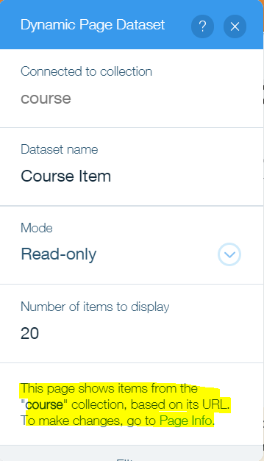
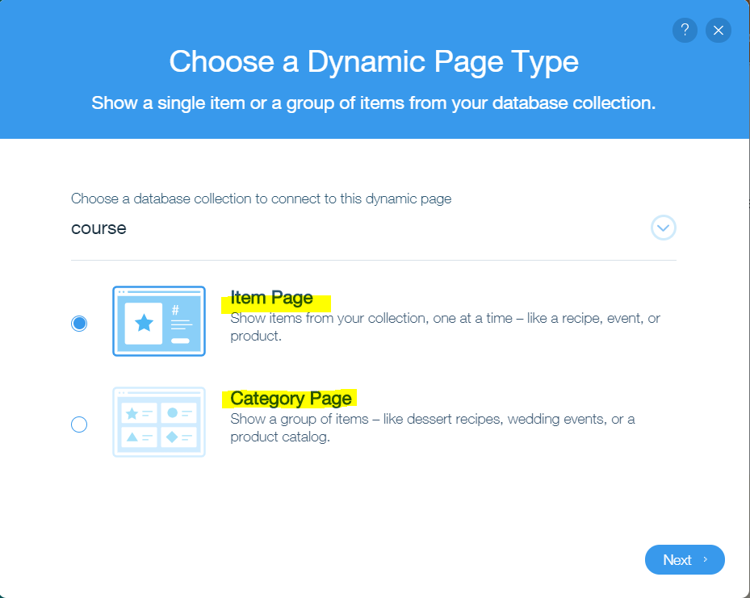
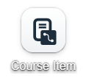
Dynamic Pages - Dataset
Item dataset
(auto generated by dynamic page)
Dataset icon

Slide 50
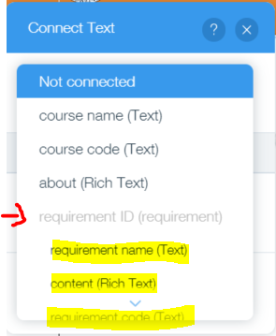
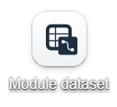
Dynamic Pages - Dataset
Field type: reference
Module
PK | Module code
 | Module name
 | content
FK | Course code
Course
PK | Course code
 | Course name
 | About
FK | Module code
FK | Requirement code
Filter: course code
includes
course item dataset
requirement
PK | Requirement code
 | content
Dataset icon

Slide 51
Dynamic Pages - Tips
Caused by dynamic contents, page height won’t be the same.
Add blank box at the end of content page
Double click “adjust page height”

Slide 52
Try yourself - Dynamic Pages
Course category
Course A page
Module A
Module B
Course B page
Module C

Slide 53
Try yourself - Dynamic Pages
Course Page (Dynamic)
Create a database collection named “entry”
Change name of default field “title” to “code”
Add “content” field in this table
Fill in 2 rows of value and sync to live
In “course” table, add field “entry ID” text and fill in all 4 records, sync to live
Connect the entry requirement with the text at bottom
Course Category (Dynamic)
Set the page to dynamic page: category page for courses.
Add a repeater to display course list
Set dataset sort by “course code” A -> Z
Module Page (Dynamic)
Add a page, and set as dynamic page: item page for modules, use “code” as URL path
Add module dataset and repeater for create a submenu, link connect to module dynamic page
display below info in the page
Module title
Module code
Module content
Commencement date
Related course
Back to Course Page (Dynamic)
Connect the buttons in module list to module dynamic page

Slide 54
Your site will transfer to you for ref
email me michellc@hku.hk if you didn’t receive the email about site transfer. (you need to accept the site transfer within 3 days)

Slide 55
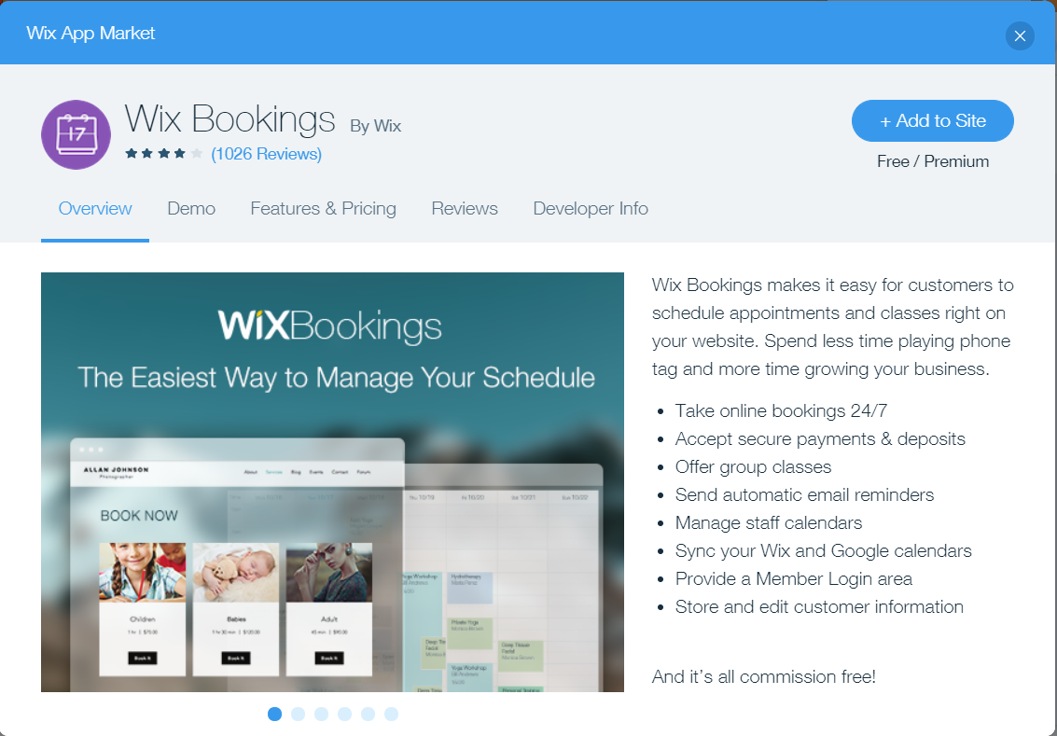
Questionnaire
Wix Module: “Wix Bookings” included in premium plan

